Slide 2
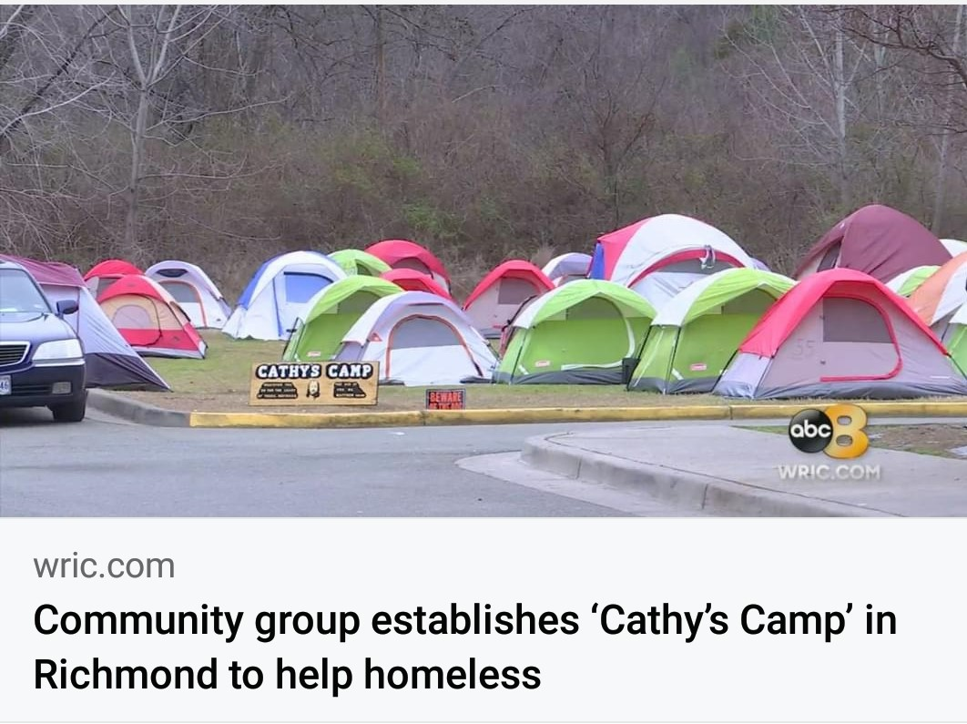

Slide 3
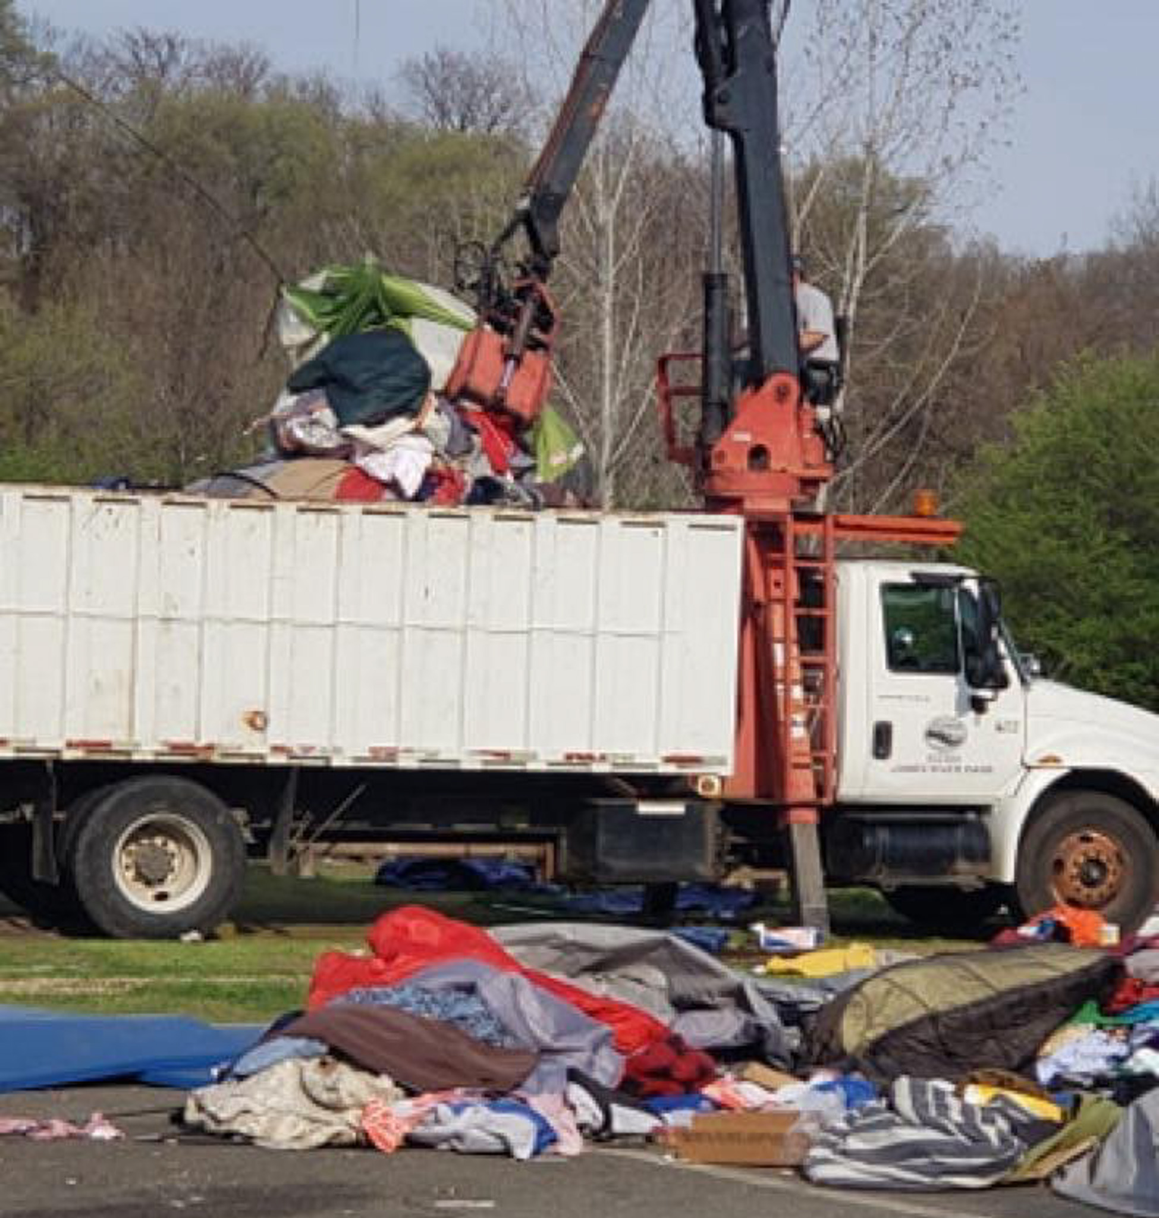

Slide 4
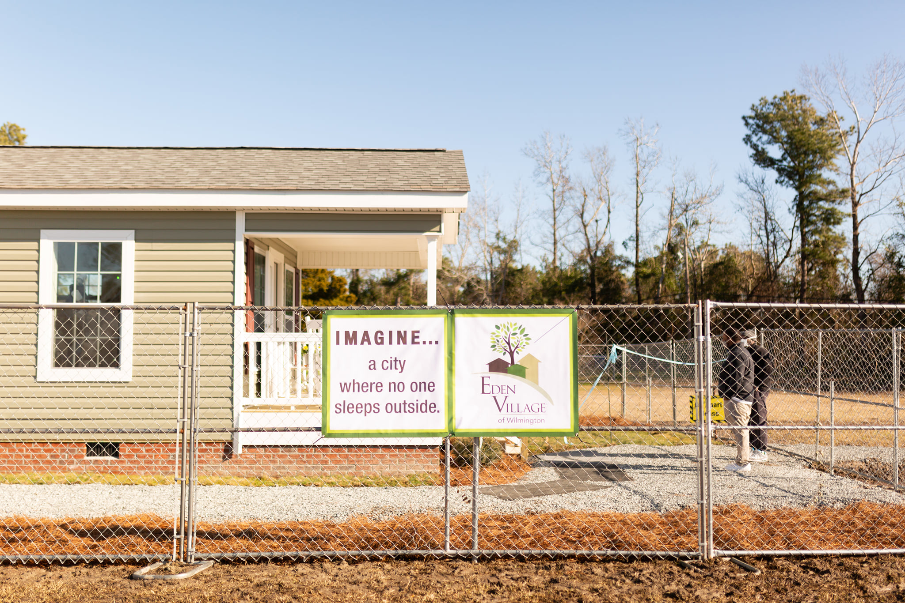

Slide 5
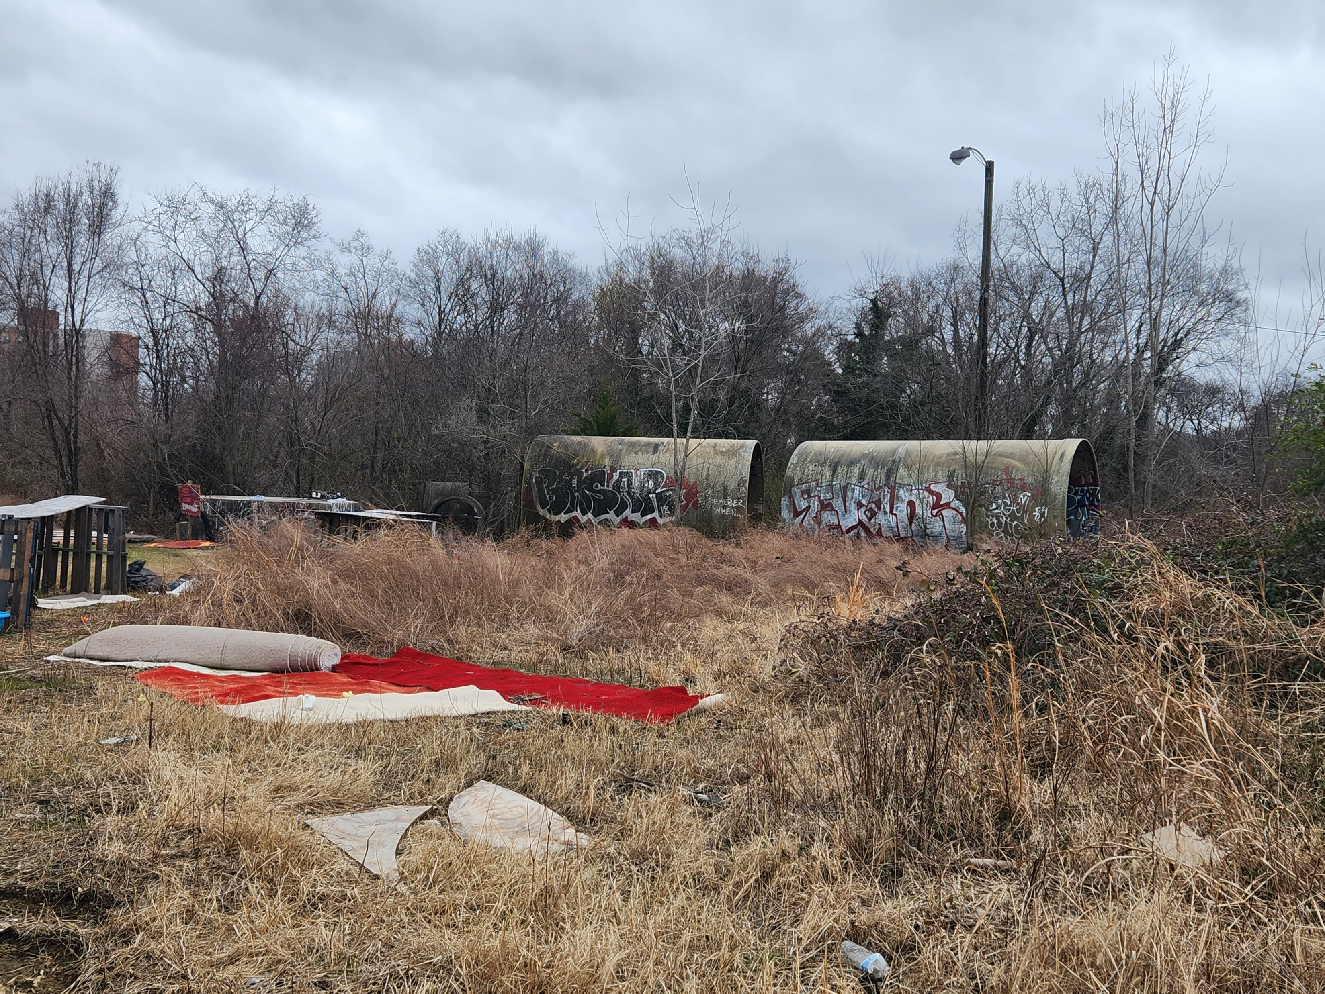

Slide 6
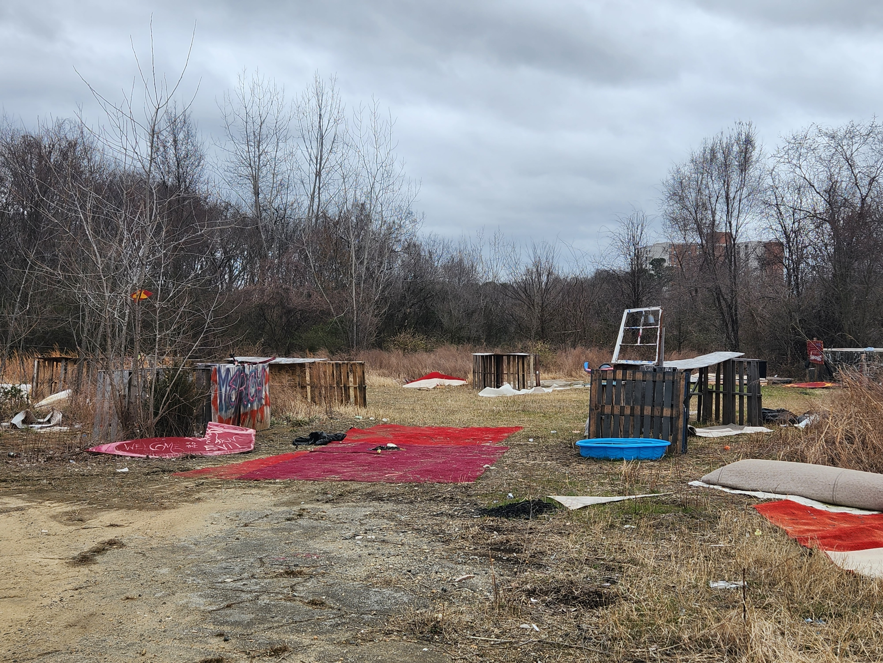

Slide 7
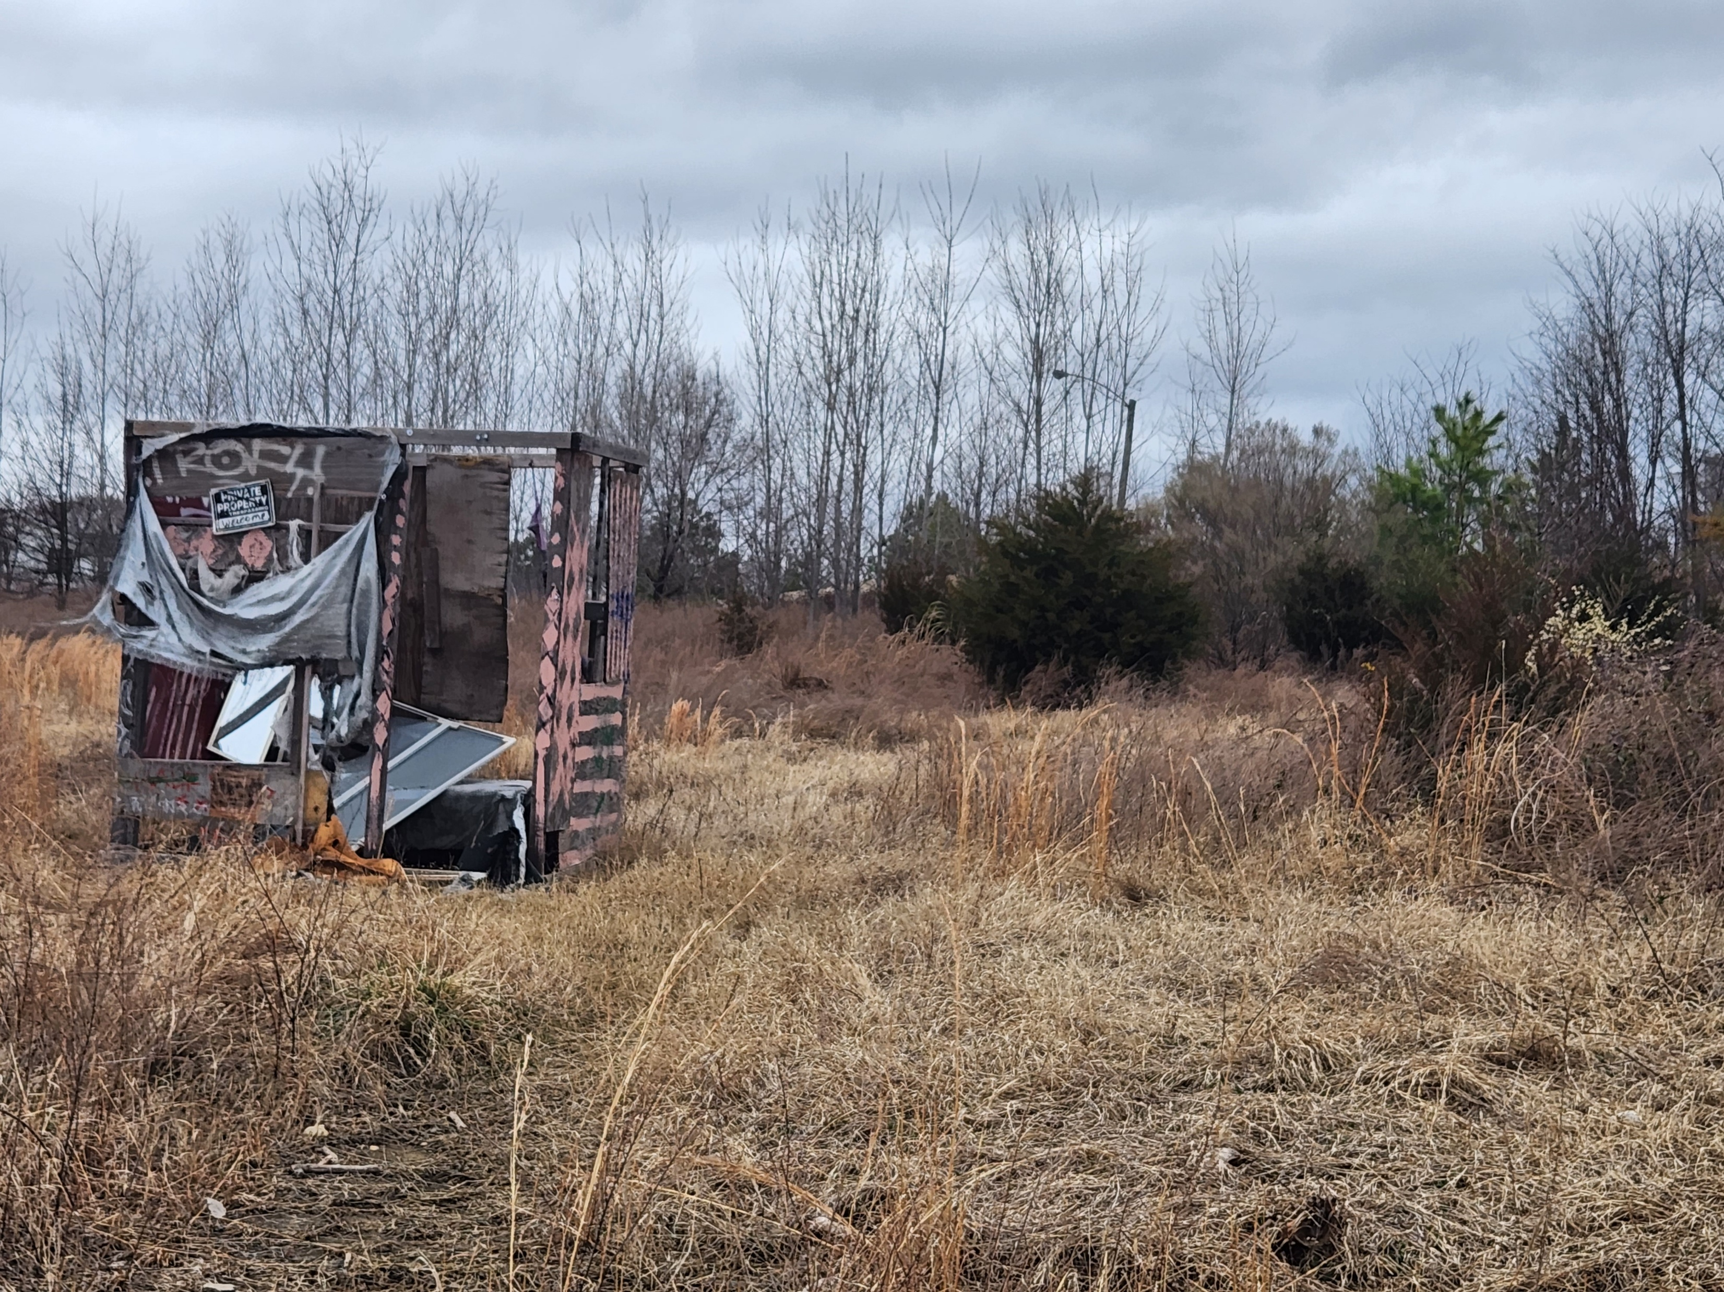

Slide 8
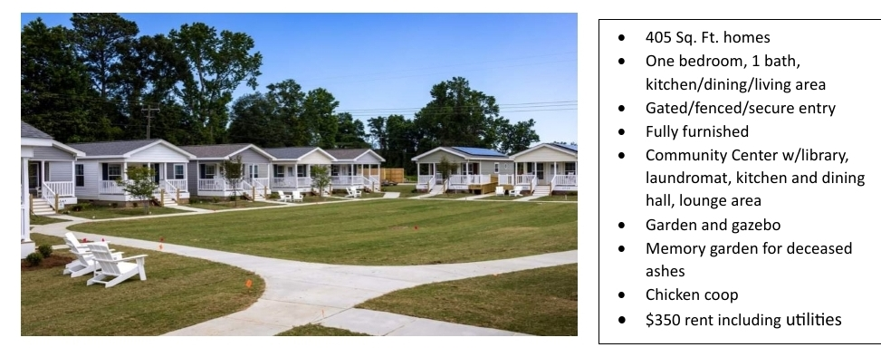

Slide 9
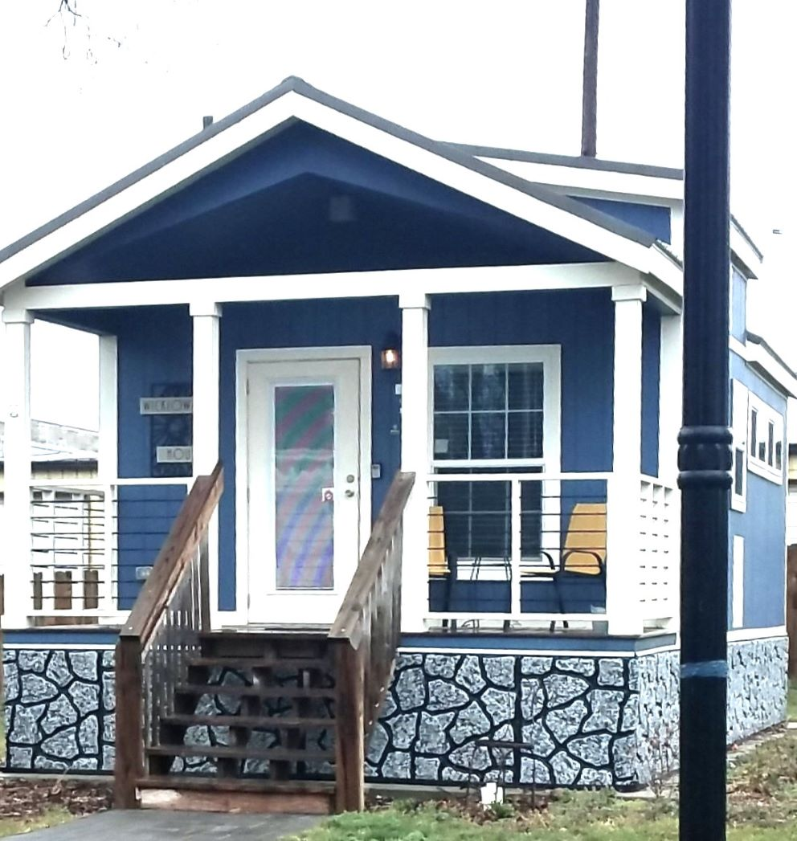

Slide 10
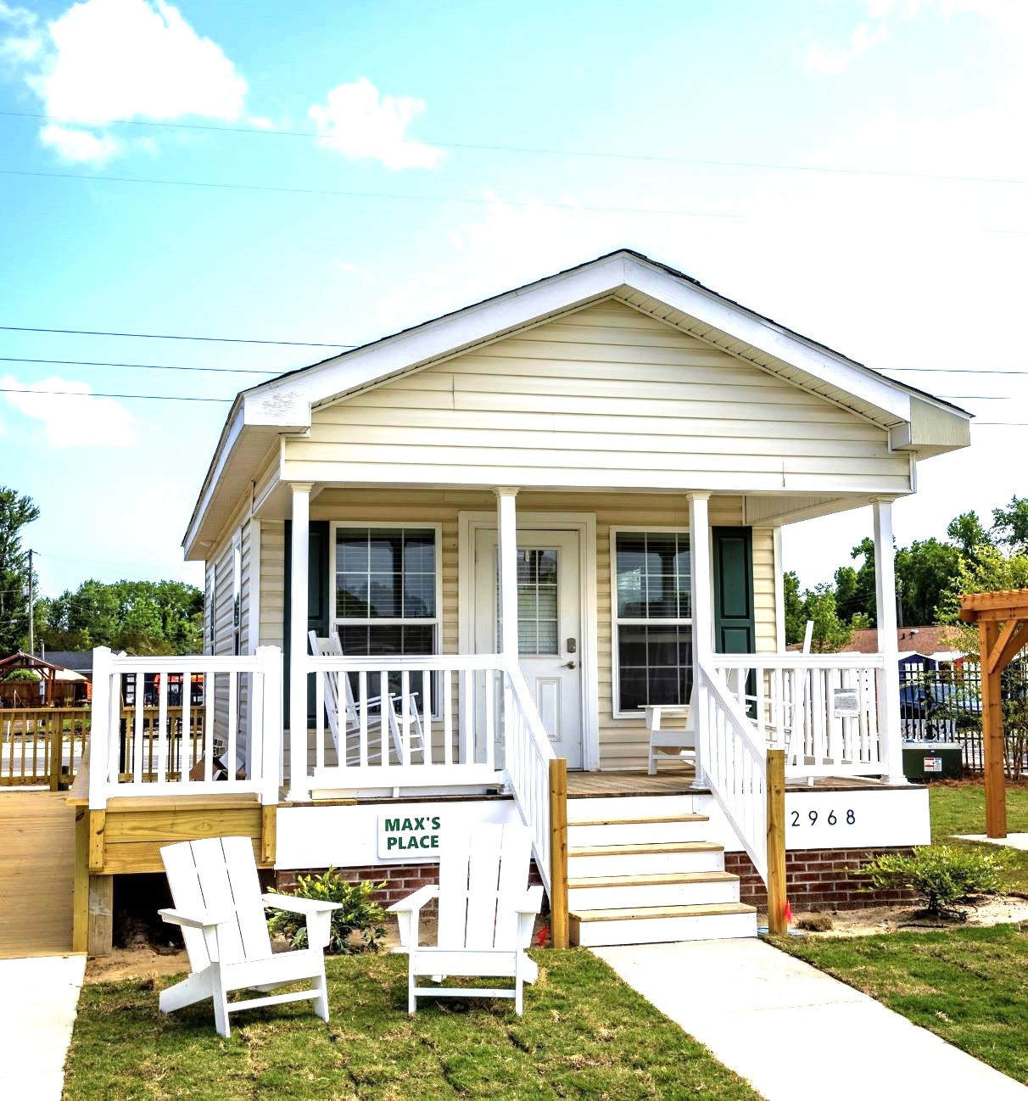

Slide 11
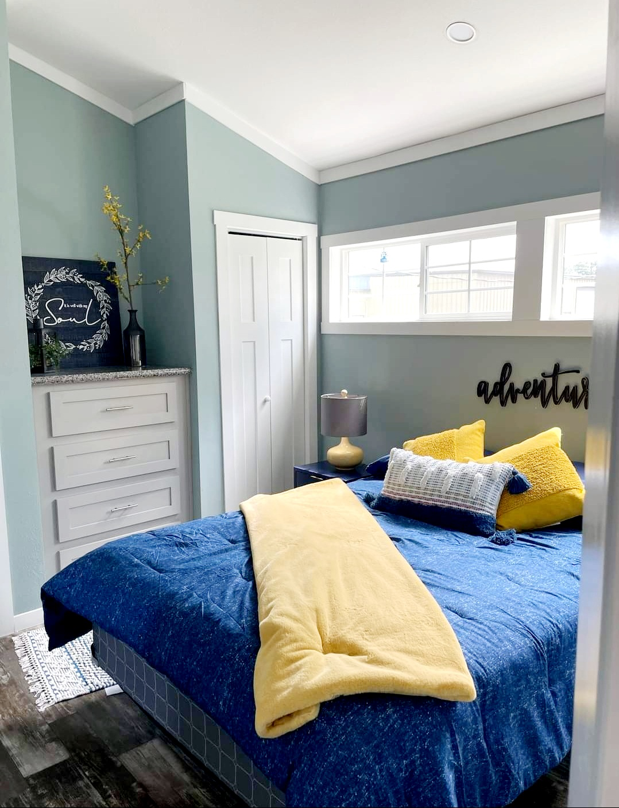

Slide 12
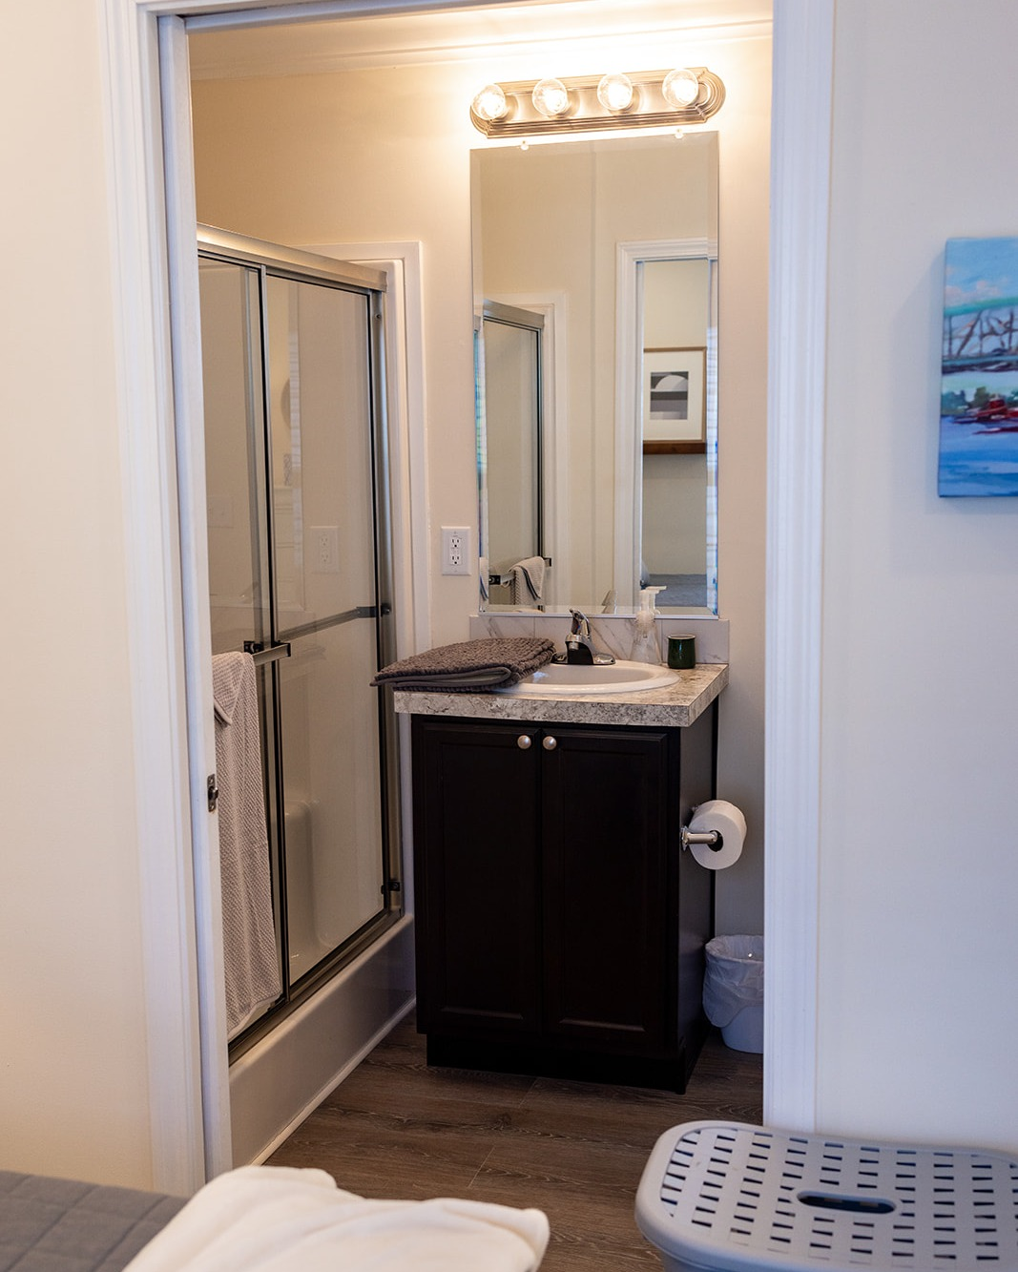

Slide 13
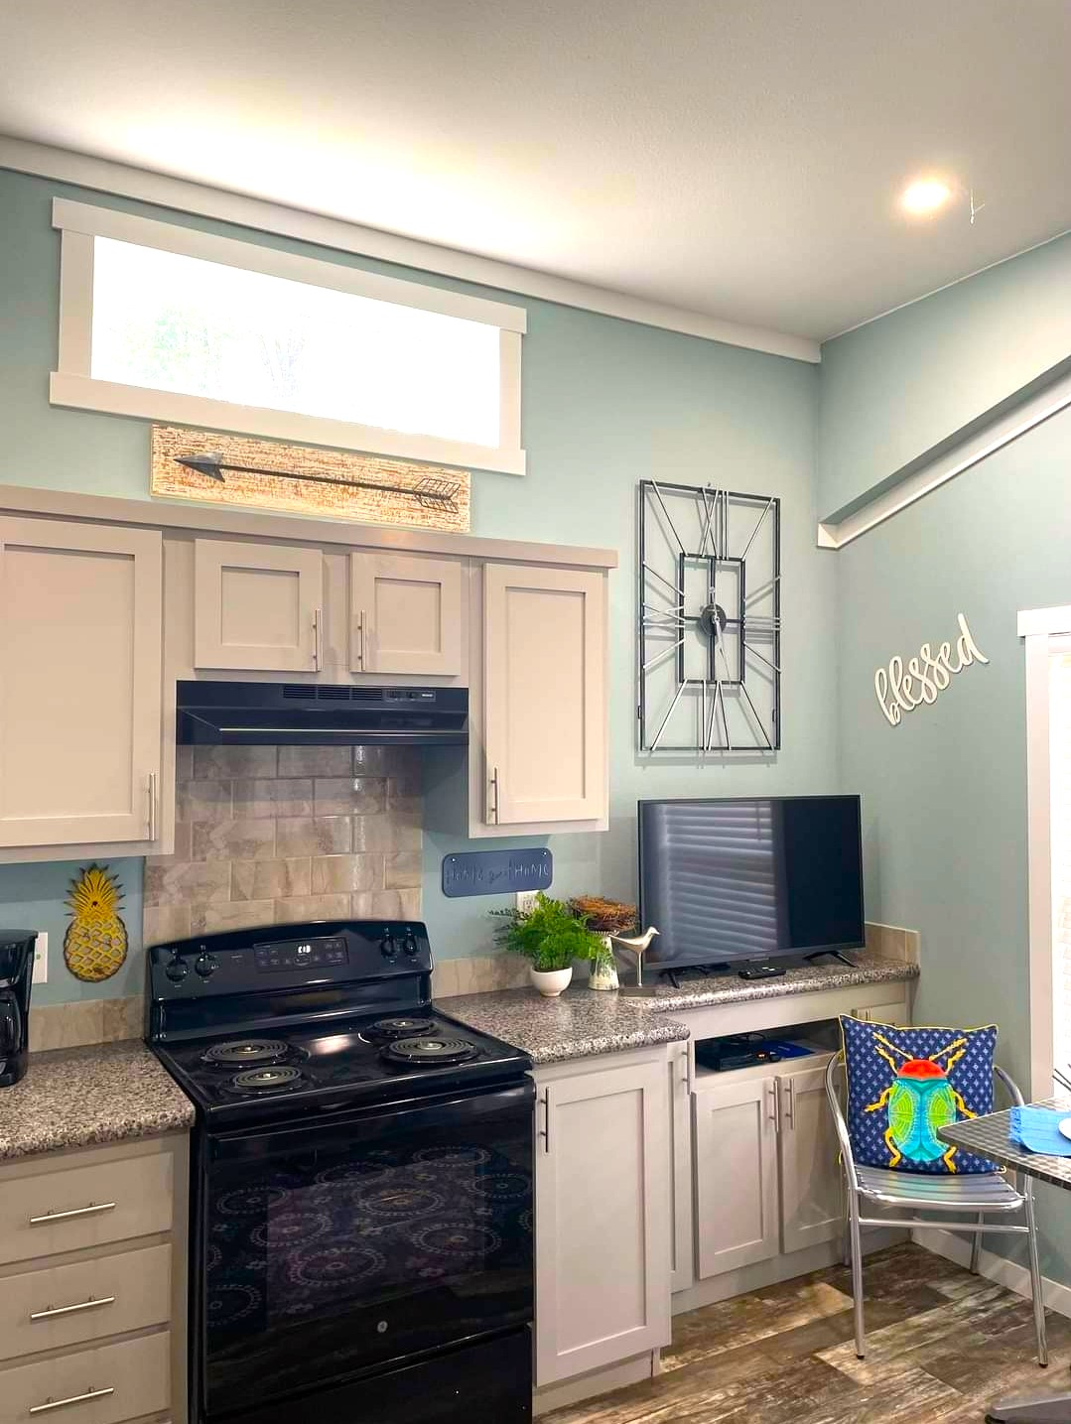

Slide 14
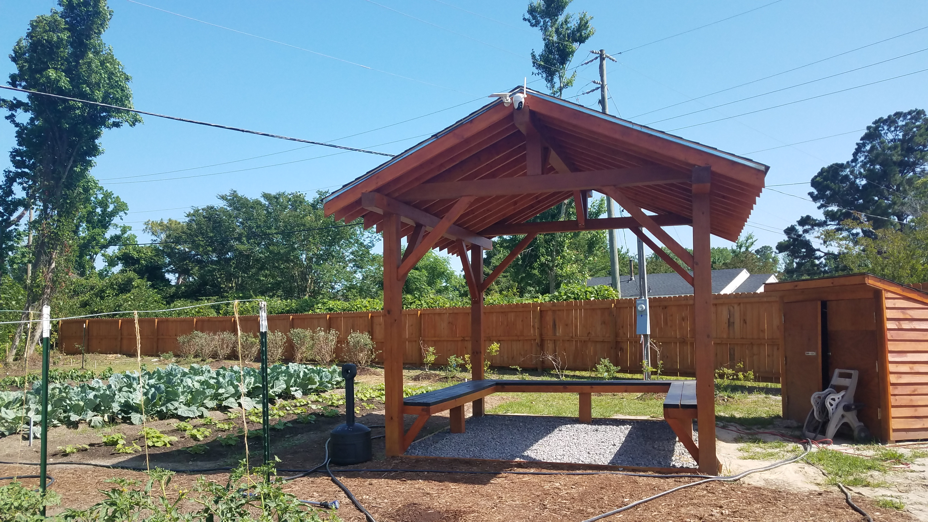

Slide 15
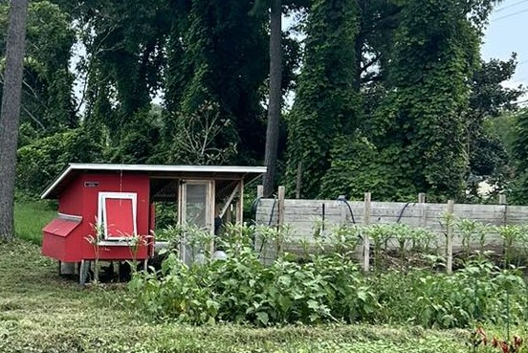

Slide 16
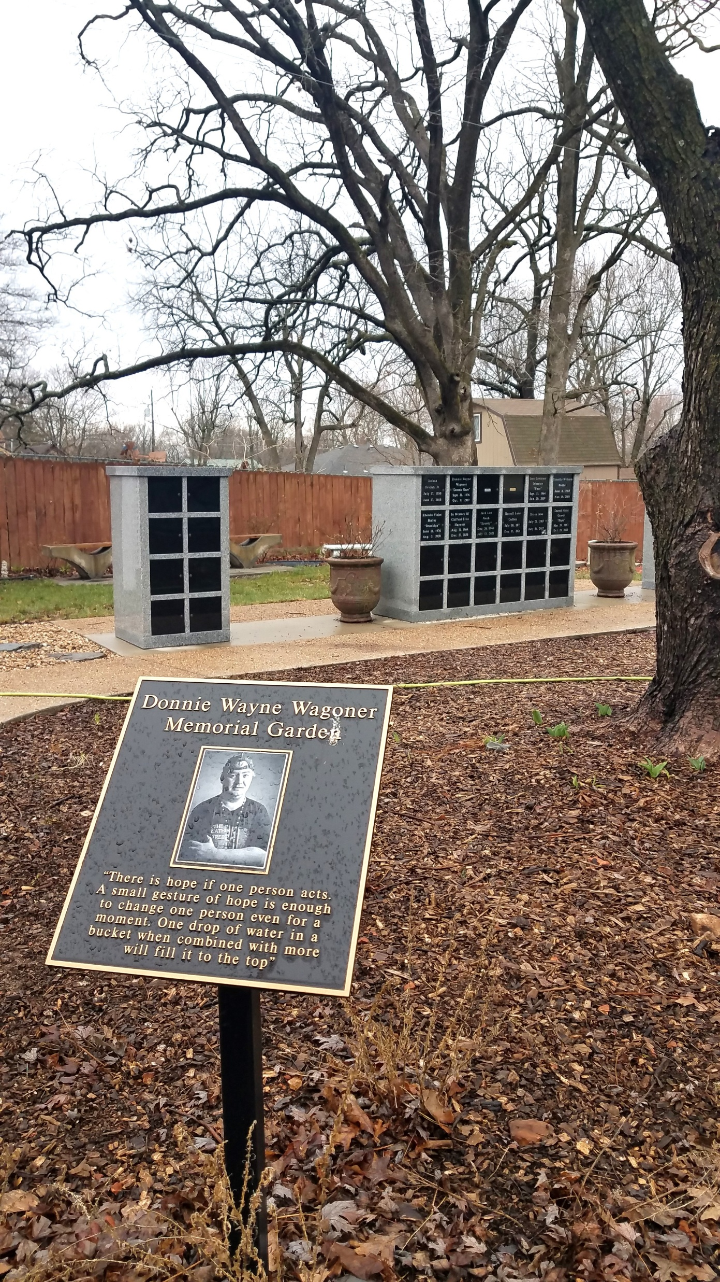

Slide 17
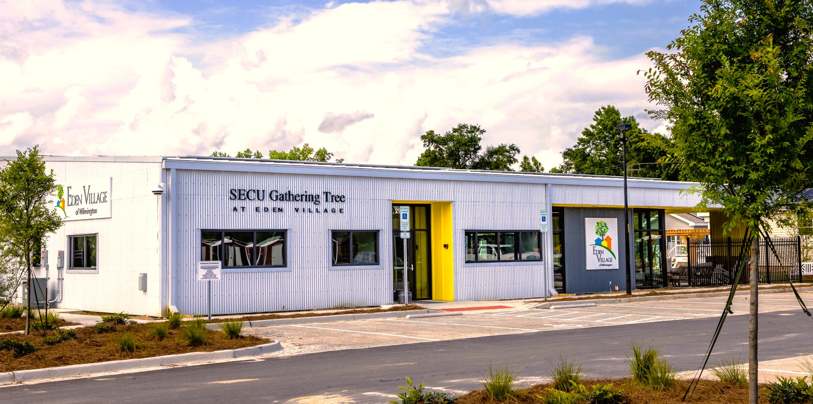

Slide 18
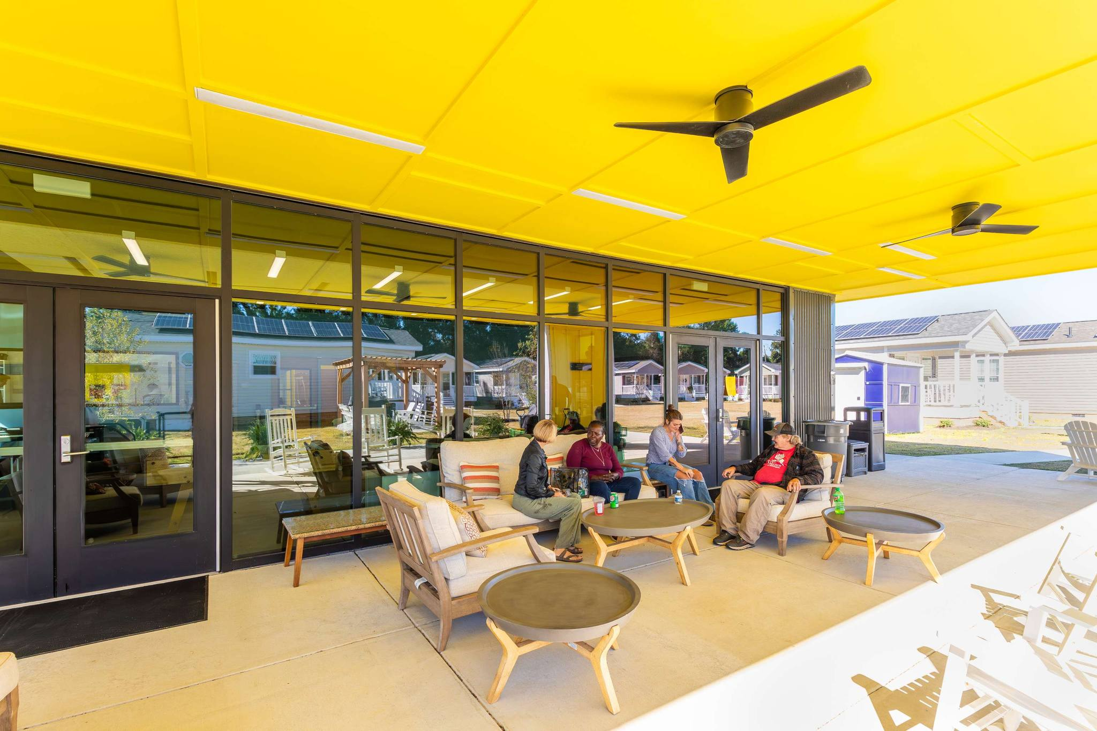

Slide 19
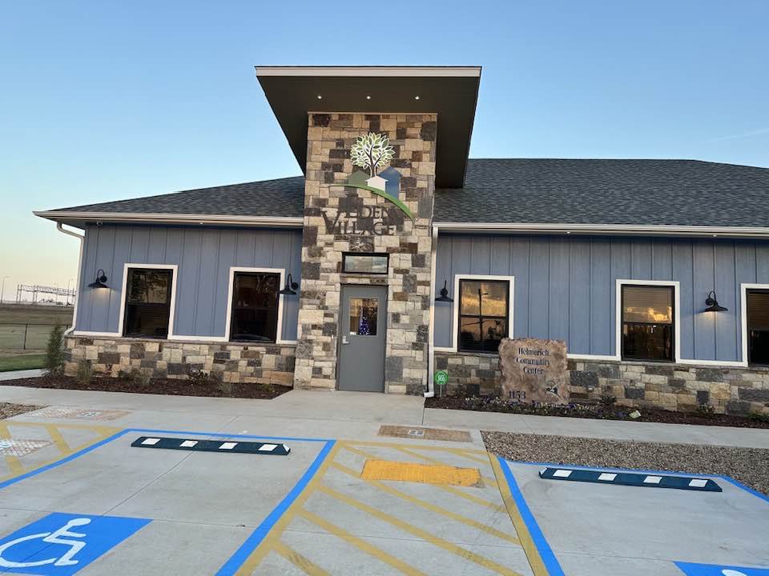

Slide 20
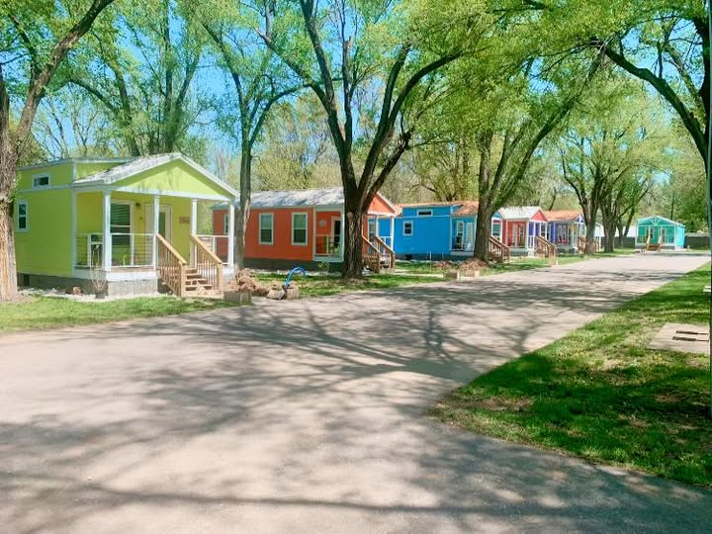

Slide 21
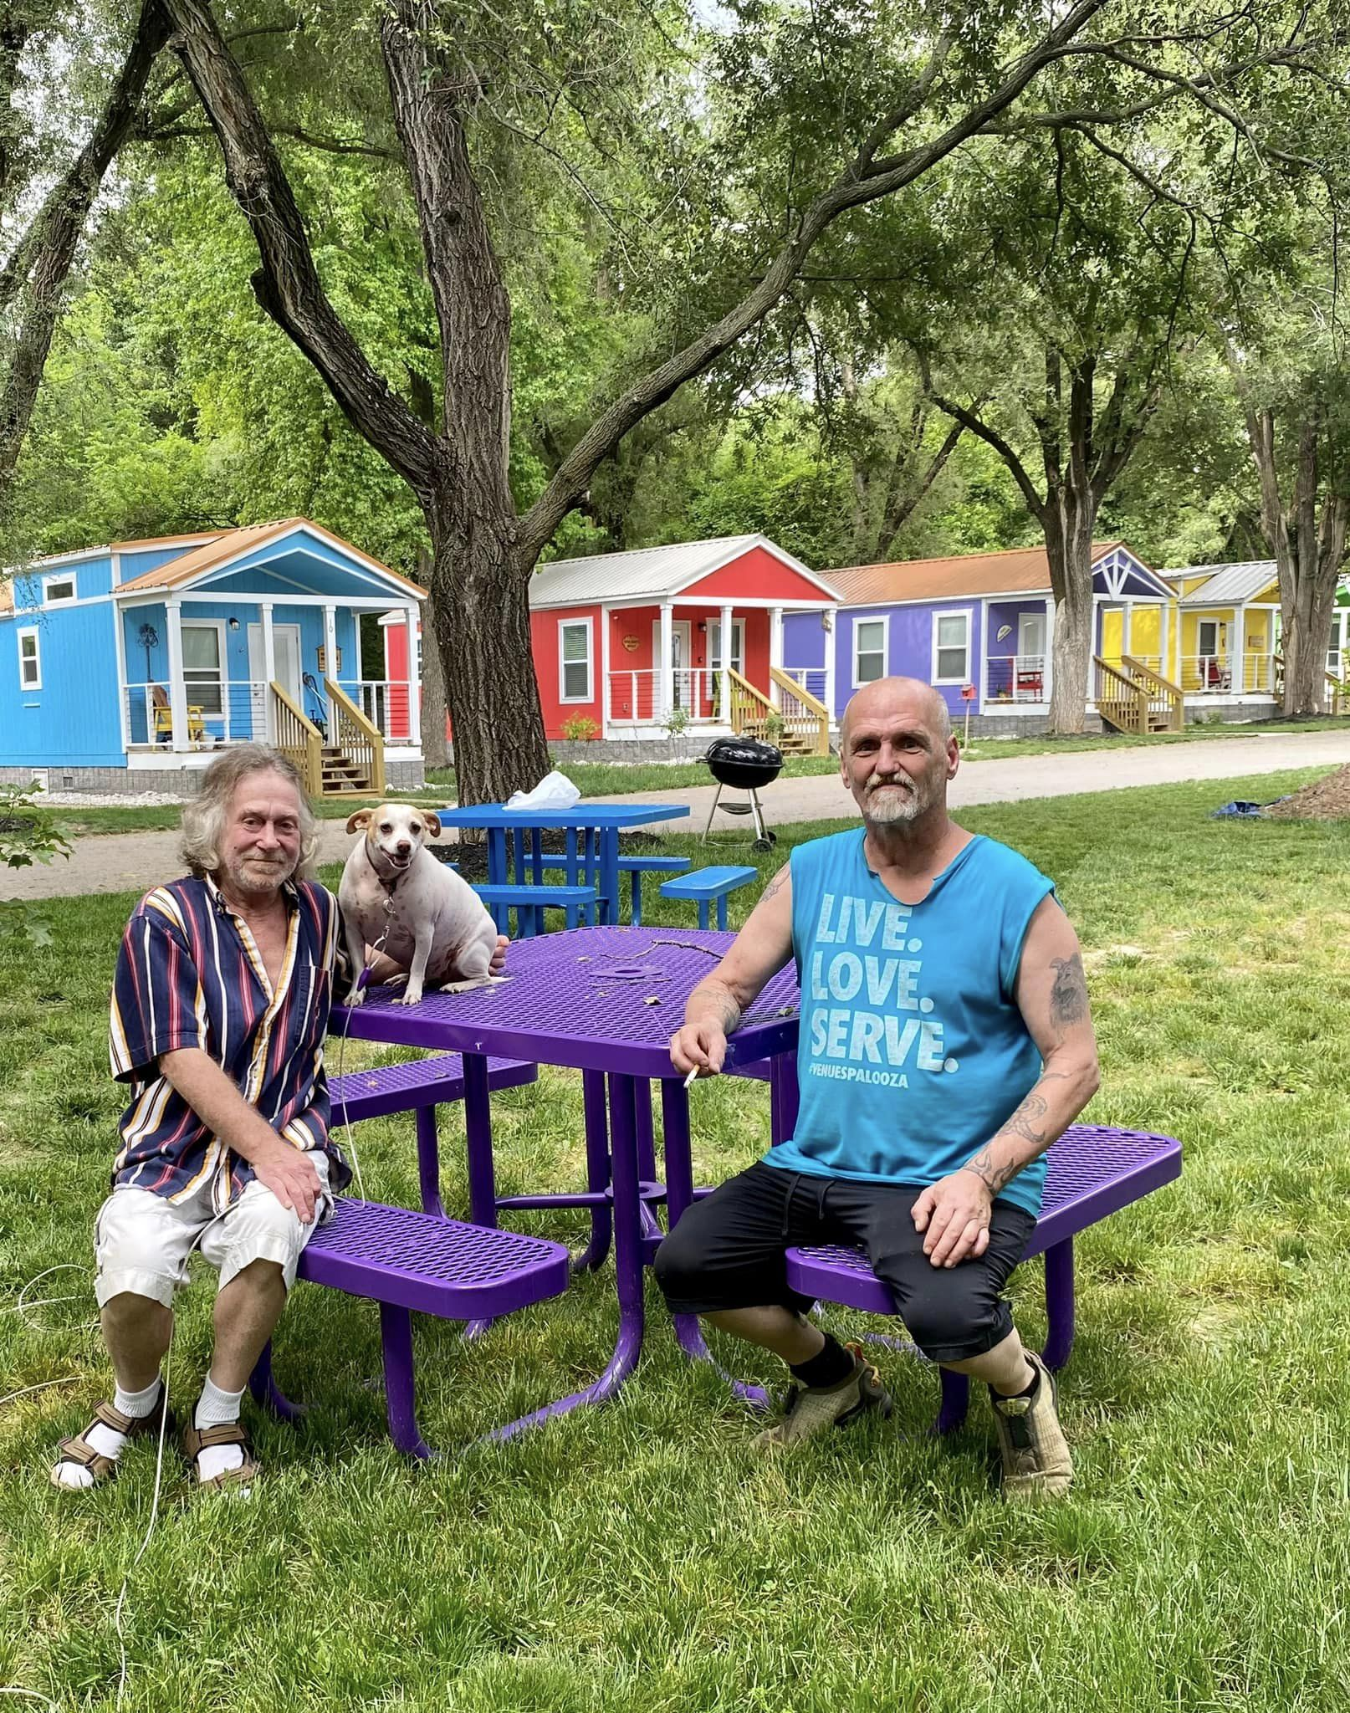

Slide 22
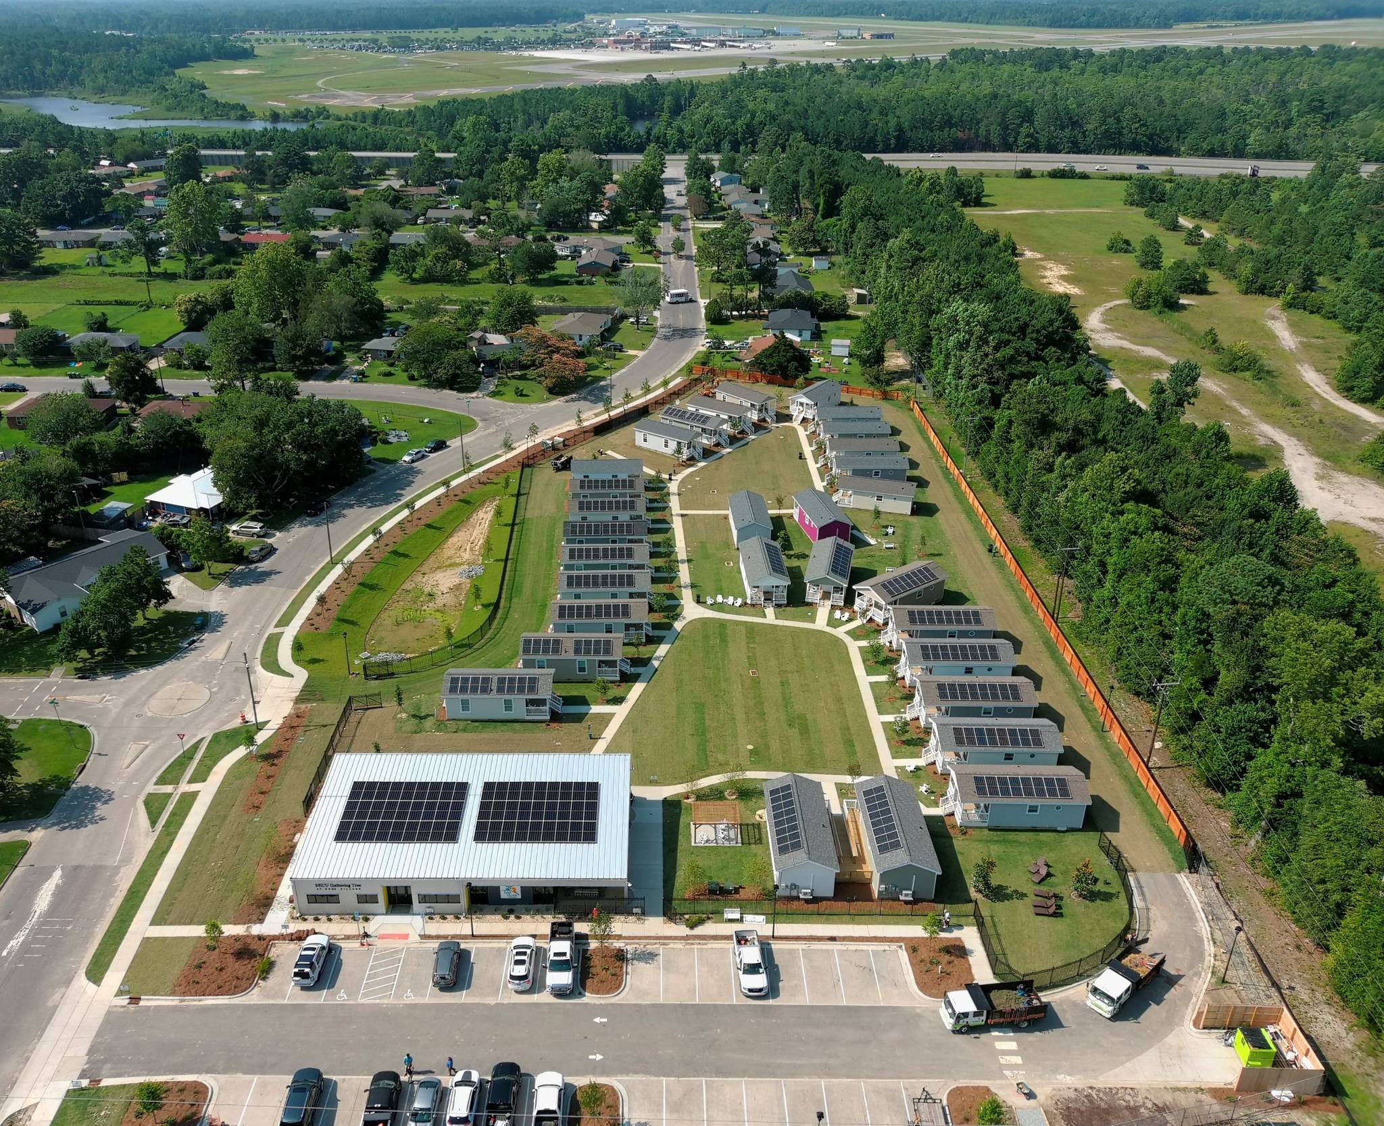

Slide 23
Mission Statement
The mission of Eden Village of Richmond is to build relationships and life-changing, affordable, individual housing communities for the homeless in partnership with other organizations, donors and volunteers in the Richmond VA area.
“Housing is Healthcare”

Slide 24
Ending homelessness is possible when we all come
together with compassion, strategy, and commitment.
With the city’s support, we’re turning an empty lot into a place of dignity and healing.

Slide 25
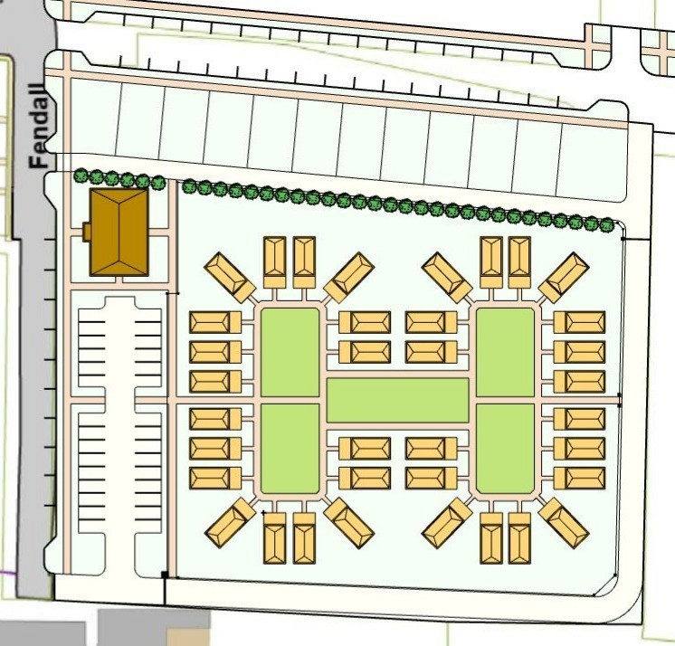
Mid-Income Homes

Slide 26
Causes of Homelessness
- Affordable Housing, Affordable Housing, Affordable Housing
Loss of job
Poverty
Chronic illness or disability
Mental Illness
Unstable family situations/Abuse
Spousal abuse
Addiction

Slide 27
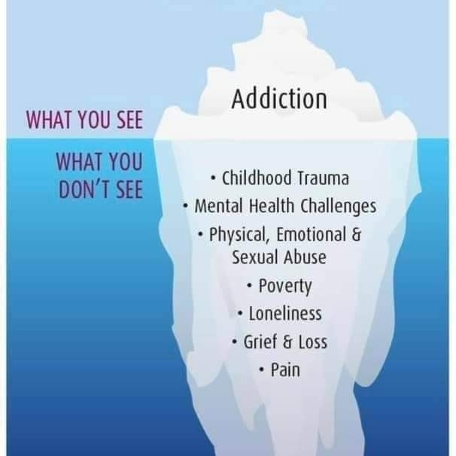

Slide 29
Cities across the US starting an Eden Village
(*** Established ** In development *Purchasing land)
*** Springfield, MO (Starting 3rd Village) 48 homes to date
*** Wilmington, NC – 31 homes/Found property for 2nd Village
*** Tulsa, OK – 15 homes occupied, 21 homes being built, 27 by late fall
*** Kansas City, KS – Developing their village/23 homes
**Phoenix, AZ – 1.58 acres/duplexes/21 homes (groundbreaking was August 2024)
* Harrisburg, PA- To build 32 homes/6.2 acres- Raising funds/Ready to start building
* Richmond, VA- Purchasing 5.6 acres from the City of Richmond to build
approximately 32-36 homes
*Excelsior Springs, MO- Raising funds to purchase land, possible contract for land
*San Marcos, TX – Beginning stages
*Mountain Home, AR – Beginning stages
*Warrenton, VA- Beginning stages
* Louisville, KY- Raising funds to purchase land
* Baton Rouge, LA- Beginning stages

Slide 30
Q: Who pays for all of this?
Grants- Federal Home Loan, Affordable Housing Trust Fund, Bank Grants, Foundation Grants
Fundraising, House parties
Sponsorships- For houses and community center/named after donor
Building mid-income housing below market rate to make some income to pay for Eden Village
Q: Advantage of the Eden Village Model:
Notoriety due to being highlighted on the Kelly Clarkson Show and a Documentary they have made about Eden Village.
Given plans for houses and community center saving hundreds of thousands of dollars
Monthly meetings to discuss what’s working and what to adjust/share information on budgets, leases, etc.
Main village has purchased a 3-D printer for us to use
National recognition helps with support:
*Accepted by cities since already proven
* Grants easier to obtain because of recognition

Slide 32
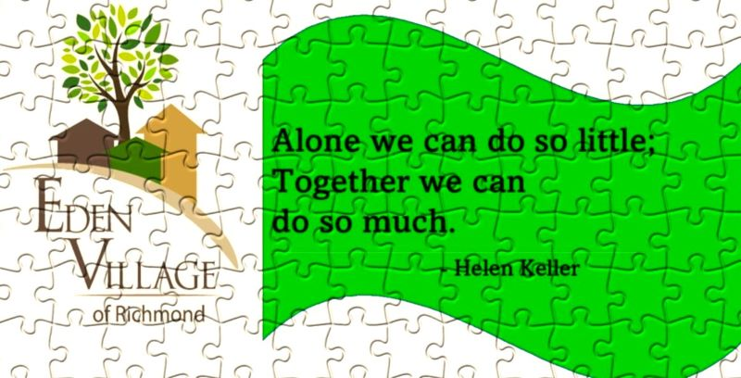
Be a Piece of the Puzzle!
Make recurring monthly donations
Of $20, $25, $30, $50, $100 or
Whatever you feel you can do!

Slide 34
You’re Invited To a House Party!
Come Watch The Eden Village Documentary
#No One Sleeps Outside
Where: Host/Adress
When: Friday, July 25th/Rain date Sat. 26th
Time: 7:30-9:00 Questions call: Phone # RSVP
A veggie tray and cheese and crackers will be served with drinks. If you prefer to bring your own drinks feel free to do.
Can’t wait to see you!

Slide 36
Retired Nurse On A Mission To Create Tiny Home Villages For Homeless

